Slide 1
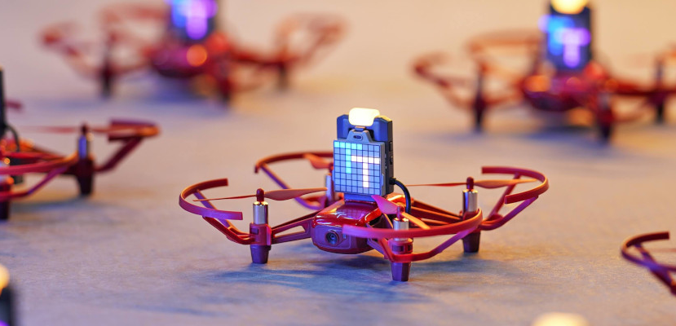
Robomaster TT(Tello Talent) Demo
Presented by: Ayemon Baraka

Slide 2
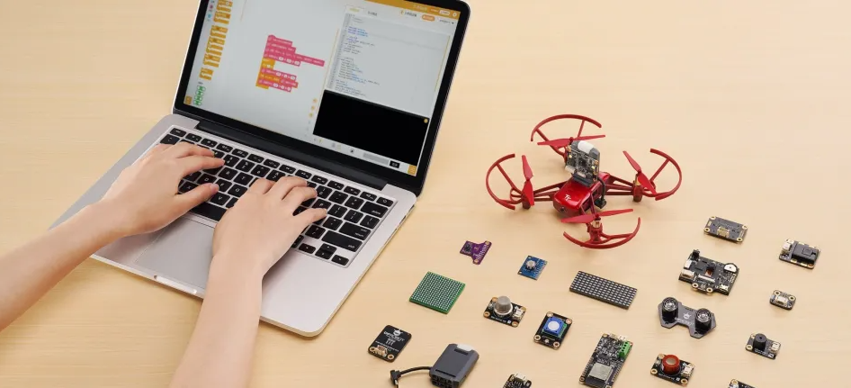
Robomaster TT(Tello Talent)

Slide 3
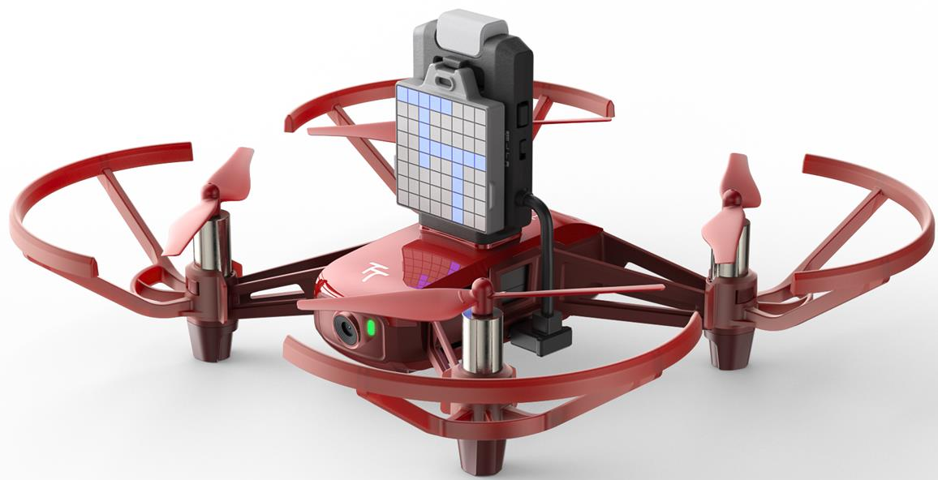
13 min |  | 100m |  | 720p
Flight Time |  | Image Transmission Distance |  | HD Transmission
Auto Takeoff/landing | Low Battery Protection |  | Failsafe Protection |  | Vision Positioning System
Lift of or land with a single tap | Alerts go off when your battery gets low |  | Land safely even if you lose connection |  | Smart tech that facilitates precise hovering

Slide 4
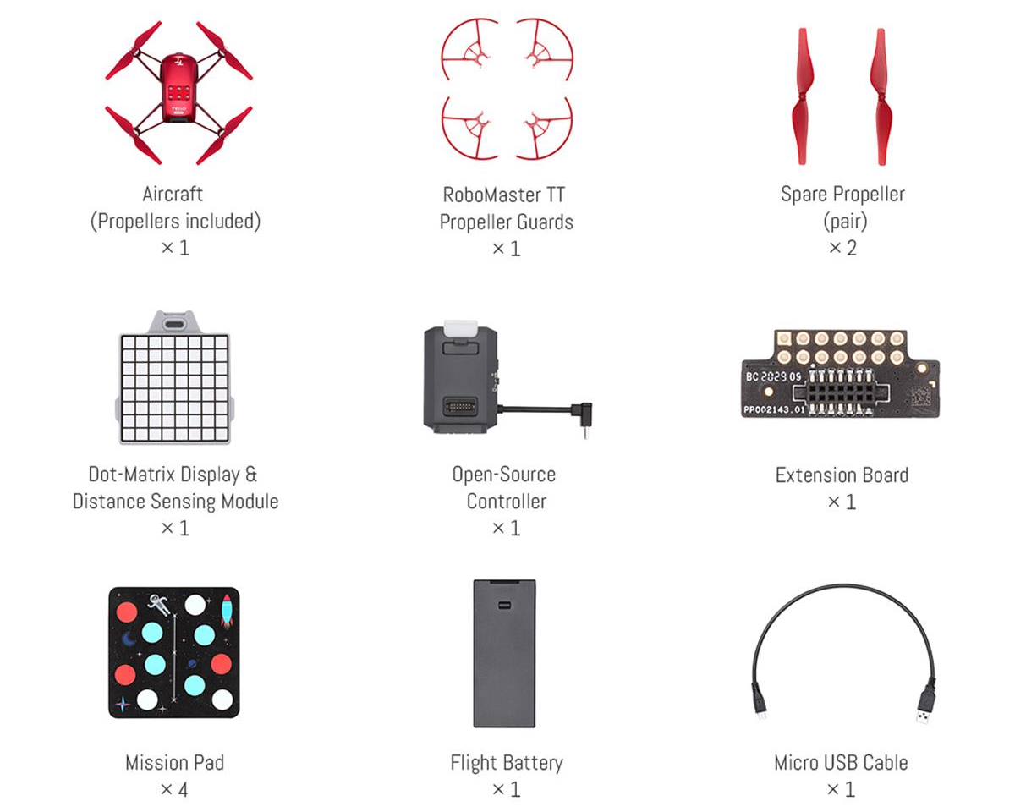

Slide 5
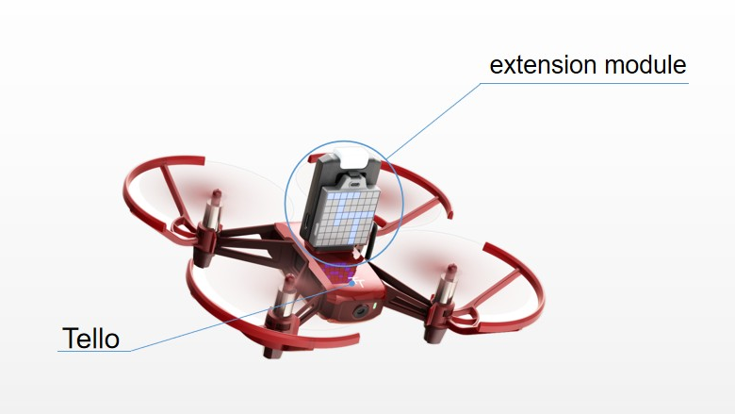

Slide 6
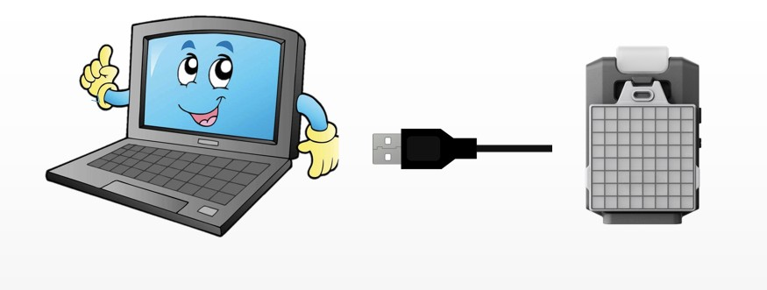

Slide 7
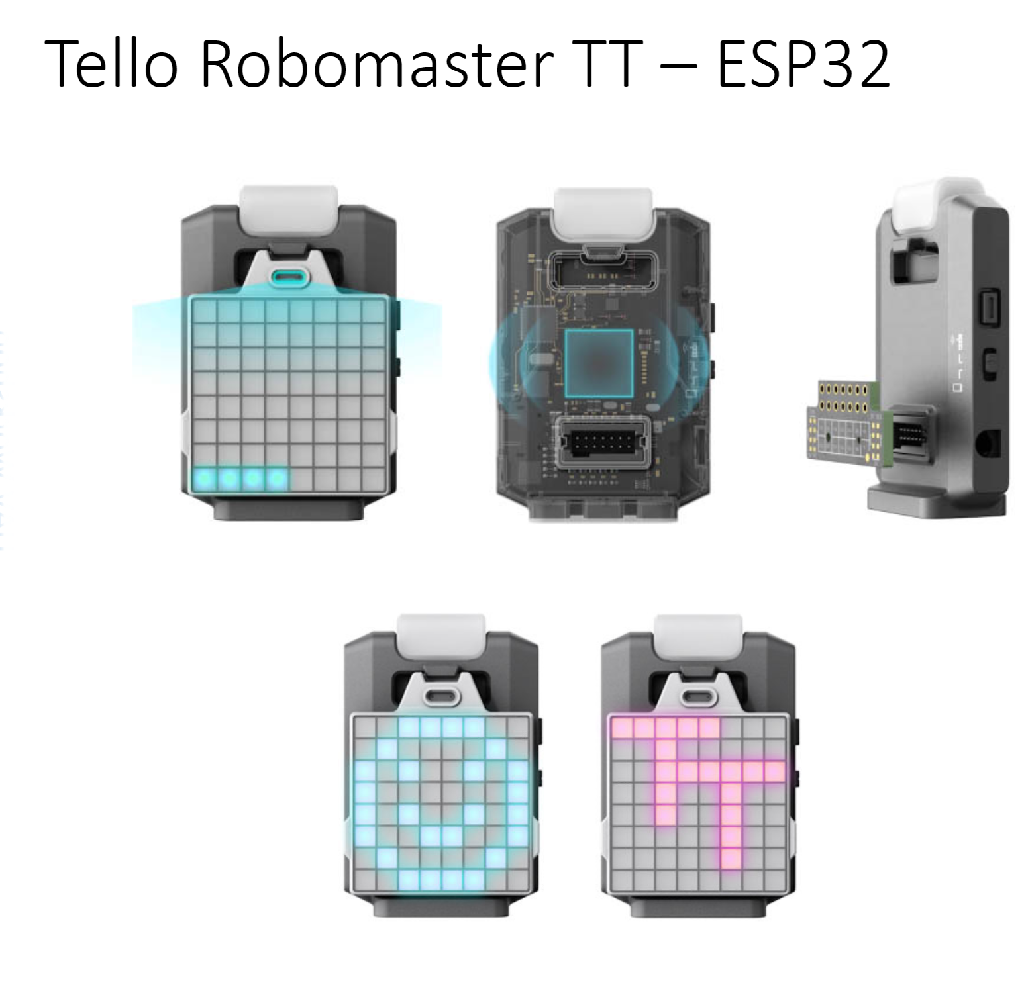

Slide 8
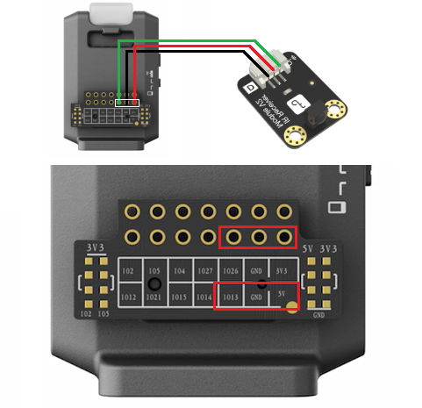
Third Party Sensor
Third Party Sensor

Slide 9
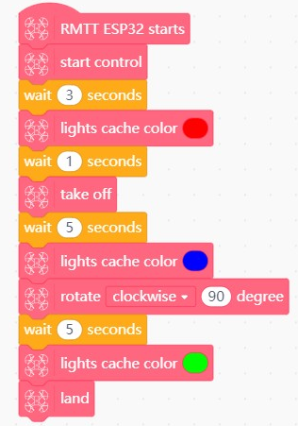
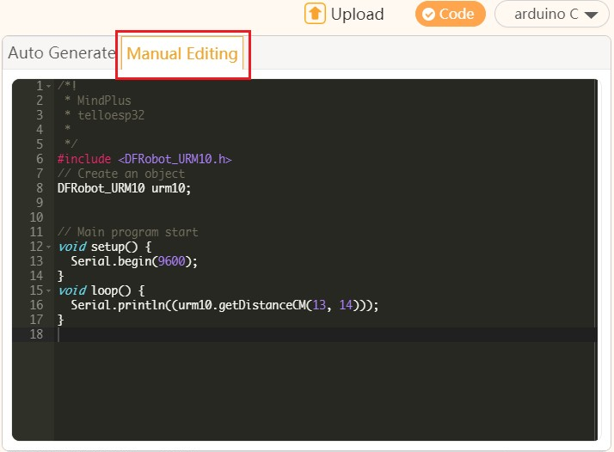
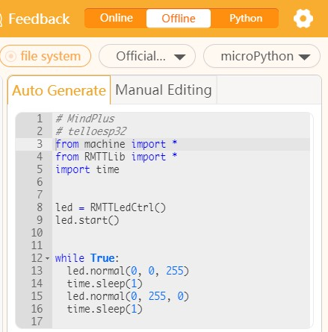
Supported Programming Language
Graphical Programming
ArduinoC
micropython

Slide 10
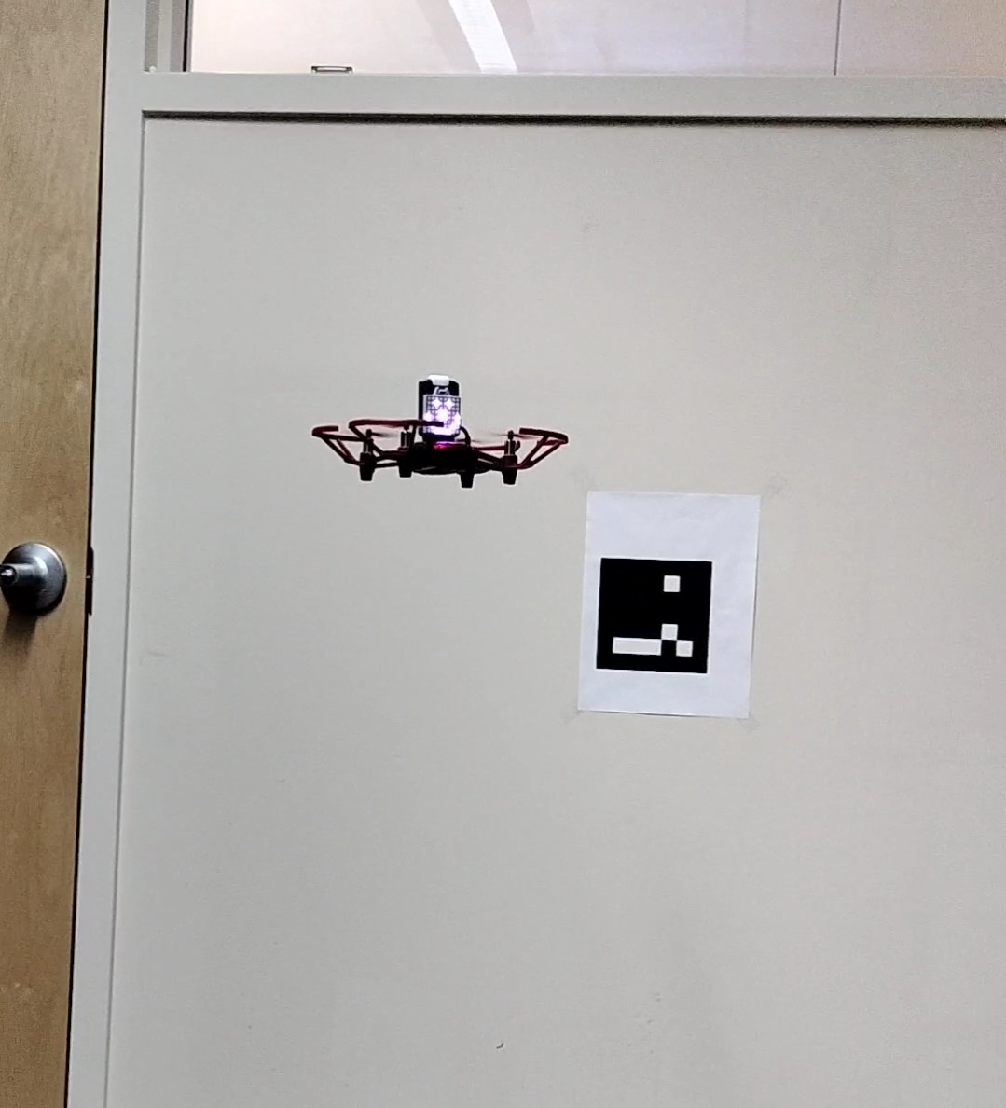
Demo – Aruco Marker Detection and Video Recording

